Slide 1

Process Mining Virtual Internship
by
Sravanthi Kuruba
Roll No. 224G1A33A6
Department of Computer Science and Engineering (AI & ML)
Srinivasa Ramanujan Institute of Technology
(Affiliated to JNTUA & Approved by AICTE) (Accredited by NAAC with ‘A’ Grade & Accredited by NBA (EEE, ECE & CSE)
Rotarypuram Village, B K Samudram Mandal, Ananthapuramu – 515701.
2023 - 2024

Slide 2

Contents
Course Objective
Introduction
Technology
Applications
Modules
Real Time applications
Learning outcomes
GitHub Link
Queries

Slide 3
Course Objective
Understand Process Mining Fundamentals : Learn the core principles and importance of process mining in business.
Analyze Real-World Data: Learn how to Apply process mining techniques to analyze real business processes.
Detect inefficiencies, delays, and areas for improvement in business workflows.
Navigate Celonis Software :Gain hands-on experience with Celonis to analyze real-world processes.

Slide 4
Introduction
I have completed this internship under Eduskills in association with AICTE.
Eduskills is a Non-profit organization which enables Industry 4.0 ready digital workforce in India.
The process mining was done in the platform of Celonis website, it helps companies achieve process, goals through its platform.
The Celonis EMS helps you not just understand your processes, but to run your entire business on data and intelligence. It provides capabilities for Real-Time Data Ingestion, Process and Task Mining, Planning and Simulation, Visual and Daily Management, and Action Flows.
Celonis is an American-German data processing company that offers software as a service (SaaS) to improve business processes

Slide 5
Technology
Celonis Platform:
Celonis 22.3
Process Mining, Process Analysis, Data integration modules

Slide 6
Applications
Celonis enables companies to streamline workflows, reduce costs, and improve productivity.
It can detect compliance violations and irregularities, allowing businesses to address risks in real time.
This leads to faster issue resolution and more efficient IT service management.
Procure-to-Pay (P2P) Efficiency
P2P reduces late payments, improves supplier relationships, and ensures timely procurement.
Order-to-Cash (O2C) Process Improvement
Celonis helps optimize the O2C process by identifying issues like delayed payments, slow invoicing, or incomplete orders.

Slide 7
Modules
What is Process Mining
Celonis Process Mining Fundamentals
Rising Star - Technical
PQL Queries
Get Data into EMS

Slide 8
What is Process Mining?
Process Mining is powerful data analysis tool .
Process mining technique helps the companies to uncover inefficiencies in their business process.
It is a technique in the field of process management that supports the analysis of business processes based on event logs and drives improved efficiency, effectiveness and compliance through its insights.
The real world examples of process mining include procurement, order management, compliance, intelligent automation, digital transformation, accounts payable, accounts receivable, auditing, IT development, service management, logistics, and many more.

Slide 9
What is Process Mining?
How to start a process?
Step-1:Identify the problem of importance to the business that can realistically be addressed with process mining. Determine the business value of solving the problem and what metrics to use to measure success.
Step-2:Identify the data sources that need to be fully understood to address the business process issues under consideration. Identify the applications and systems that need to provide feeds of event data for continuous visibility into end-to-end processes.
Step-3:Set up a pilot project to prove the potential value of a process mining solution. Ensure that the project can be executed relatively quickly and deliver specific, measurable results that everyone in the organization can understand.
Step-4:Accepting the results of the analysis, as process mining provides, among other things, a clear picture based on facts.

Slide 10
Celonis Process Mining Fundamentals
Process mining is a set of techniques used for obtaining knowledge and extracting insights from processes.
This training track provides both the theoretical and applied foundations around Process Mining.
Process mining reads this data, converts it into an event log, and then creates visualizations of the end-to-end process, along with insightful analytics.
An event log contains each step performed during the process , the time at which the event
occurred , and for which instance of the process.
Using this event log, algorithms generate a process model that shows the process.

Slide 11
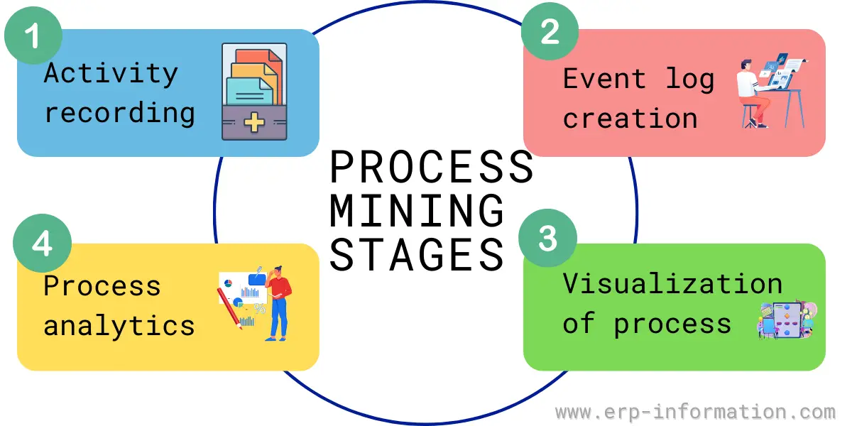
Celonis Process Mining Fundamentals
Main Stages in Process Mining:
Activity or interaction.
Event Log.
Visualized.
Process Analytics.

Slide 12
RISING STAR- TECHNICAL
This refers to emerging trends and advancements in process mining, such as new algorithms, techniques, and tools that enhance the capabilities and applications of process mining.
Under this we mainly learn about two topics:
PQL Queries
Get Data into Ems

Slide 13
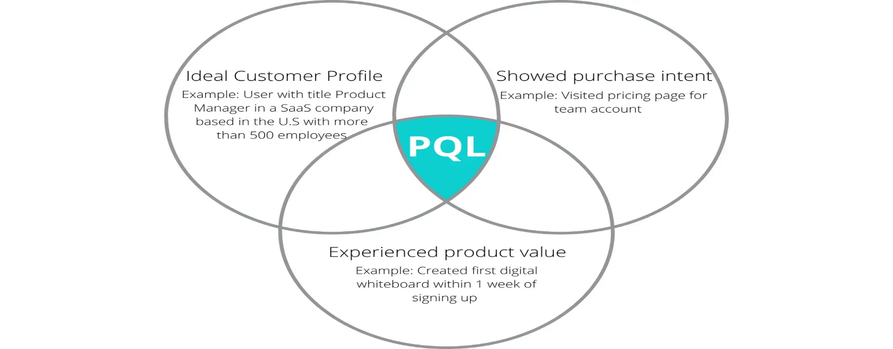
RISING STAR- TECHNICAL
PQL Queries:
PQL (Process Query Language) is a specialized language used to query process mining tools. It allows users to retrieve specific information from event logs and process models.
With PQL, you can ask questions about process performance, identify deviations from expected behavior, or extract patterns and trends from the process data.

Slide 14
RISING STAR- TECHNICAL
Get Data into EMS:
To import data into an EMS, you can collect event logs from various sources, such as system logs, databases, or other applications.
These event logs serve as the input for process mining analysis.
These sources may include transactional systems, databases, application logs, or any other system that generates event data.
Once the event logs are imported into the EMS, they can be used as input for process mining analysis.

Slide 15

RISING STAR- TECHNICAL
Get Data into EMS:

Slide 16
Real Time Applications
BMW (Automotive)
BMW applied Celonis process mining to improve the efficiency of its supply chain and manufacturing processes. The insights gained helped BMW reduce production lead times and optimize resource utilization.
Dell (Technology)
Dell uses Celonis to improve its Order-to-Cash process. By analyzing order fulfillment and delivery processes, Dell reduced order processing times and improved customer satisfaction.
Uber (Transportation/Logistics)
Uber implemented Celonis to optimize its global financial processes, such as billing and invoicing. It identified inefficiencies in payments and significantly improved its financial reporting accuracy and speed.

Slide 17
Learning Outcomes
Understand how to extract, transform, and load (ETL) data into Celonis from various systems for effective process analysis.
Find and fix slow or broken steps in the workflow. Example: Identify and remove extra steps that slow down delivery times.
Learn to visualize and analyze end-to-end business processes using real-time data, identifying inefficiencies and process deviations.
Learn to gather and prepare data for analysis.
Example: Pull data from different systems to see all sales activities.

Slide 18
Conclusion
Process Mining helps us to optimize service costs. It Interpret process visualizations and
analyses to identify process inefficiencies It Process the Huge data.
By combining process mining fundamentals with rising star technical topics, organizations can unlock the full potential of process mining and drive continuous improvement in their business processes.

Slide 19
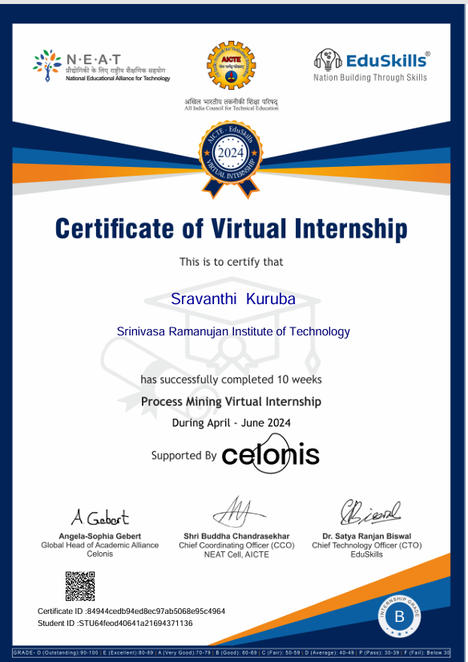
Certificate

Slide 20
Any Queries?

Slide 21
Thank You!!!

